Slide 2
Topics
Introduction to Functions
Classification of Functions
Defining and Calling a Void Function
Designing a Program to Use Functions
Local Variables
Passing Arguments to Functions
Global Variables and Global Constants
Turtle Graphics: Modularizing Code with Functions

Slide 3
Topics (cont’d.)
Introduction to Value-Returning Functions: Generating Random Numbers
Writing Your Own Value-Returning Functions
The math Module
Storing Functions in Modules

Slide 4
Introduction to Functions
Function: group of statements within a program that perform as specific task
  Usually one task of a large program
    Functions can be executed in order to perform overall program task
  Known as divide and conquer approach
Modularized program: program wherein each task within the program is in its own function

Slide 5



What is Function?
A function is a group of statements that is executed when it is called from some point of the program.
It’s a divide and conquer approach

Slide 6
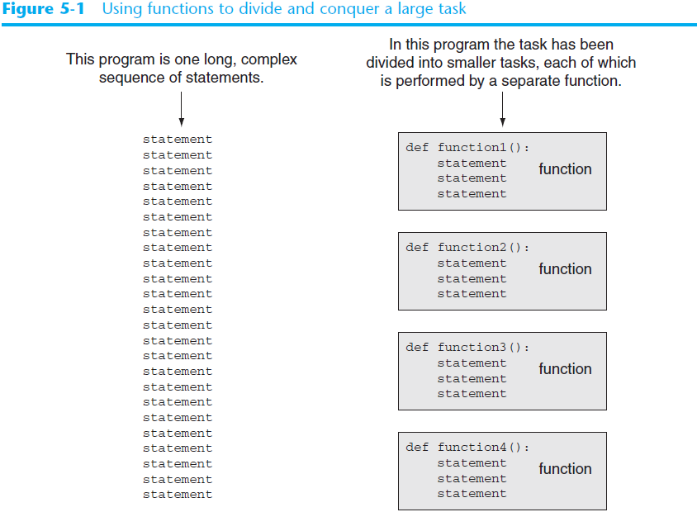
Divide and Conquer

Slide 7
Benefits of Modularizing a Program with Functions
The benefits of using functions include:
  Simpler code
  Code reuse
    write the code once and call it multiple times
  Better testing and debugging
    Can test and debug each function individually
  Faster development
  Easier facilitation of teamwork
    Different team members can write different functions

Slide 8

CLASSIFICATION OF FUNCTIONS

Slide 9

TYPES OF FUNCTIONS
Functions can be categorized into three types:-
1) Built in Functions.
2) Modules.
3) User - defined functions.

Slide 10

TYPES OF FUNCTIONS
1) BUILT IN FUNCTIONS
These are predefined function in python and are used as and when there is need by simply calling them. For example:
int()
float()
str()
min()
max() ...etc

Slide 11


TYPES OF FUNCTIONS
2) MODULES
Module is a container of functions, variables, constants, class in a separate file which can be reused.

Slide 12

IMPORTING MODULES
i) Import statement
ii) from statement

Slide 13

IMPORTING MODULES – import STATEMENT
i) import statement : used to import entire module.
Syntax: import modulename
example: import math

Slide 14

IMPORTING MODULES – import STATEMENT
ii) from: import all functions or selected one.
Syntax:
from module name import function name
for example:
from random import randint

Slide 15

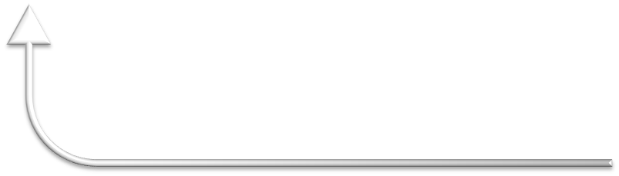

3) USER DEFINED FUNCIONS
Function is a set of statements that performs specific task.
Syntax of user defined function
def function_name(list of parameters)
................
................
Statements
def is keyword

Slide 16
Syntax:
  def functionname( parameters ):
  "function_docstring"
  function_suite
  return [expression]
By default, parameters have a positional behavior, and you need to inform them in the same order that they were defined.
Example:
  def printme( str ):
  "This prints a passed string function"
  print str
  return

Slide 17
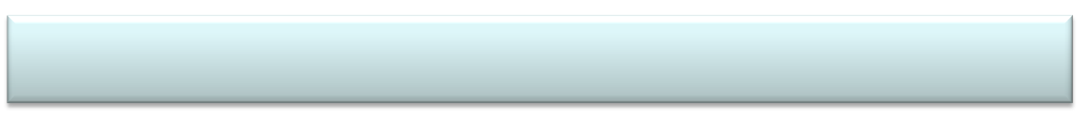
Example - USER DEFINED FUNCIONS
def sum_diff(x,y):
add=x+y
diff=x-y
return add,diff
def main():
x=9
y=3
a,b=sum_diff(x,y)
print("Sum = ",a)
print("diff = ",b)
main()

Slide 18
Classificaiton of User-Defined Functions

Slide 19
Void Functions and Value-Returning Functions
A void function:
  Simply executes the statements it contains and then terminates.
A value-returning function:
  Executes the statements it contains, and then it returns a value back to the statement that called it.
    The input, int, and float functions are examples of value-returning functions.

Slide 20
Types of Value Returning User-Defined Functions
Returning and accepting values
  With arguments and No return values
  With arguments and With return values
  No arguments and With return values

Slide 21
Defining and Calling a Function
Functions are given names
  Function naming rules:
    Cannot use key words as a function name
    Cannot contain spaces
    First character must be a letter or underscore
    All other characters must be a letter, number or underscore
    Uppercase and lowercase characters are distinct

Slide 22
Defining and Calling a Function (cont’d.)
Function name should be descriptive of the task carried out by the function
  Often includes a verb
Function definition: specifies what function does
  def function_name():
    statement
    statement

Slide 23
Defining and Calling a Function (cont’d.)
Function header: first line of function
  Includes keyword def and function name, followed by parentheses and colon
Block: set of statements that belong together as a group
  Example: the statements included in a function

Slide 24
Defining and Calling a Function (cont’d.)
Call a function to execute it
  When a function is called:
    Interpreter jumps to the function and executes statements in the block
    Interpreter jumps back to part of program that called the function
      Known as function return

Slide 25
Defining and Calling a Function (cont’d.)
main function: called when the program starts
  Calls other functions when they are needed
  Defines the mainline logic of the program

Slide 26
Indentation in Python
Each block must be indented
  Lines in block must begin with the same number of spaces
    Use tabs or spaces to indent lines in a block, but not both as this can confuse the Python interpreter
    IDLE automatically indents the lines in a block
  Blank lines that appear in a block are ignored

Slide 27
Designing a Program to Use Functions
In a flowchart, function call shown as rectangle with vertical bars at each side
  Function name written in the symbol
  Typically draw separate flow chart for each function in the program
    End terminal symbol usually reads Return
Top-down design: technique for breaking algorithm into functions

Slide 28
Designing a Program to Use Functions (cont’d.)
Hierarchy chart: depicts relationship between functions
  AKA structure chart
  Box for each function in the program, Lines connecting boxes illustrate the functions called by each function
  Does not show steps taken inside a function
Use input function to have program wait for user to press enter

Slide 29
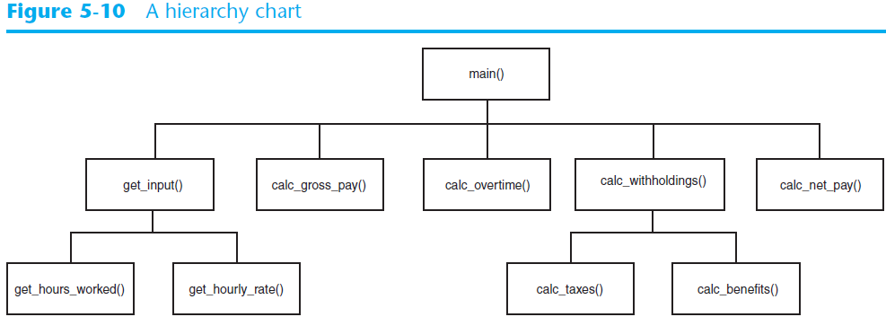
Designing a Program to Use Functions (cont’d.)

Slide 30




PARAMETERS AND ARGUMENTS IN FUNCTION
Parameters are the values which are provided at the time of function definition.
def sum_diff(p,q):
add=p+q
diff=p-q
return add,diff
Parameters
Parameter is also called as formal parameter

Slide 31



PARAMETERS AND ARGUMENTS IN FUNCTION
Arguments are the values which are passed while calling a function
def main():
x=9
y=3
a,b=sum_diff(x,y)
print("Sum = ",a)
print("diff = ",b)
main()
Arguments
Argument is also called as actual parameter

Slide 32

Python supports following type of arguments:
TYPES OF ARGUMENTS
Positional arguments
Default Arguments
Keyword Arguments
Variable Length Arguments

Slide 33

These are the arguments passed to a function in correct positional order
1. POSITIONAL ARGUMENTS
For example:
def substract(a,b):
print(a-b)
substract()
>>substract(100,200)
-100
>>substract(150,100)
50

Slide 34

When a function call is made without arguments, the function has defalut values for it for example:
2. DEFAULT ARGUMENTS
For example:
def greet_msg(name=“Mohan”):
print(“Hello “, name)
greet_msg(“Vinay”) # valid
greet_msg() #valid

Slide 35

if function containing many arguments, and we wish to specify some among them, then value for such parameter can be provided by using the name
3. KEYWORD ARGUMENTS
For example:
def greet_msg(name,msg):
print(name,msg)
#calling function
greet_msg(name=“Mohan”,msg=“Hi”): # valid
O/p -> Mohan Hi

Slide 36

4. VARIABLE LENGTH ARGUMENTS
In some situation one needs to pass as many as argument to a function, python provides a way to pass number of argument to a function, such type of arguments are called variable length arguments.
Variable length arguments are defined with * symbol.
For Example: (next slide)

Slide 37

4. VARIABLE LENGTH ARGUMENTS
For Example:
def sum(*n):
total=0
for i in n:
total+=i
print(“Sum = “, total)
sum()
# Calling function
sum() o/p sum=0
sum(10) o/p sum=10
sum(10,20,30,40) o/p sum=100

Slide 38

SCOPE OF VARIABLES
Scope mean measure of access of variable or constants in a program. Generally there are two types of scope of variables:
i) Global (Module)
ii) Local (Function)
Global variables are accessed throughout the program their scope is global
Local variables are accessed within the program and their scope is local only.

Slide 39
Local Variables
Local variable: variable that is assigned a value inside a function
  Belongs to the function in which it was created
    Only statements inside that function can access it, error will occur if another function tries to access the variable
Scope: the part of a program in which a variable may be accessed
  For local variable: function in which created

Slide 40
Local Variables (cont’d.)
Local variable cannot be accessed by statements inside its function which precede its creation
Different functions may have local variables with the same name
  Each function does not see the other function’s local variables, so no confusion

Slide 41



GLOBAL & LOCAL VARIABLES
For Example:
def main():
x=9
y=3
a,b=add_diff(x,y)
print("Sum = ",a)
print("diff = ",b)
print("m in main function = ",m)
main()
GLOBAL VARIABLE
LOCAL VARIABLES
m=100
def add_diff(x,y):
add=x+y
diff=x-y
global m
m= m +10
print("m in add_diff function=",m)
return add,diff

Slide 42
Passing Arguments to Functions
Argument: piece of data that is sent into a function
  Function can use argument in calculations
  When calling the function, the argument is placed in parentheses following the function name

Slide 43
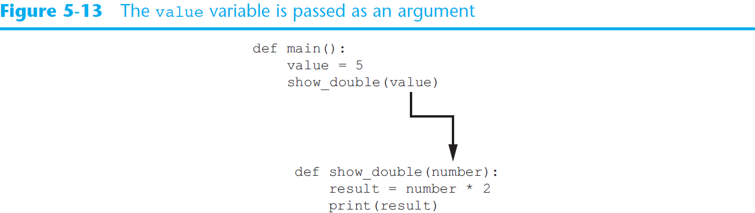
Passing Arguments to Functions (cont’d.)

Slide 44
Passing Arguments to Functions (cont’d.)
Parameter variable: variable that is assigned the value of an argument when the function is called
  The parameter and the argument reference the same value
  General format:
  def function_name(parameter):
  Scope of a parameter: the function in which the parameter is used

Slide 45
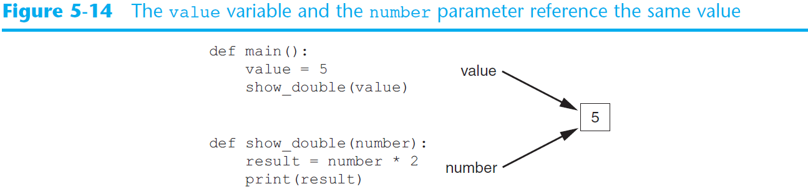
Passing Arguments to Functions (cont’d.)

Slide 46
Passing Multiple Arguments
Python allows writing a function that accepts multiple arguments
  Parameter list replaces single parameter
    Parameter list items separated by comma
Arguments are passed by position to corresponding parameters
  First parameter receives value of first argument, second parameter receives value of second argument, etc.

Slide 47
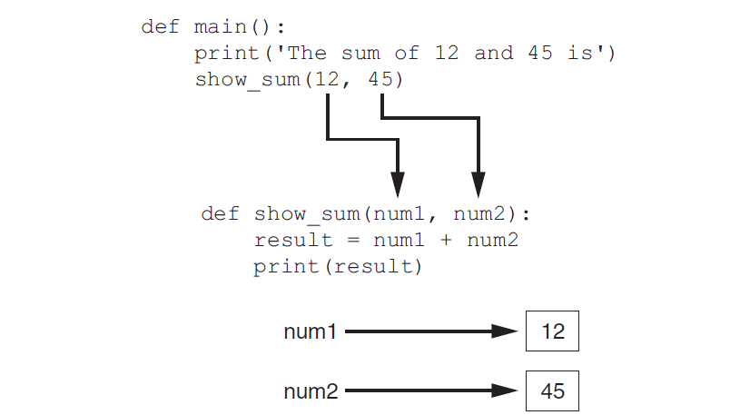
Passing Multiple Arguments (cont’d.)

Slide 48
Making Changes to Parameters
Changes made to a parameter value within the function do not affect the argument
  Known as pass by value
  Provides a way for unidirectional communication between one function and another function
    Calling function can communicate with called function

Slide 49
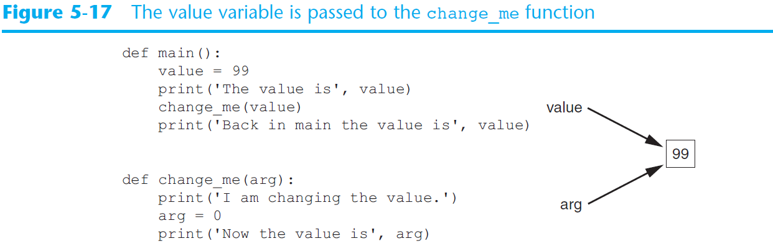
Making Changes to Parameters (cont’d.)

Slide 50
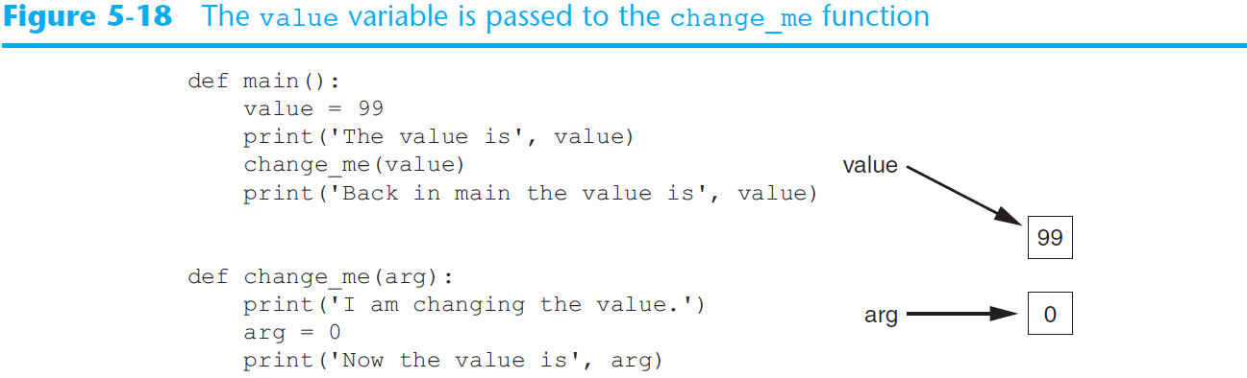
Making Changes to Parameters (cont’d.)
  The value variable passed to the change_me function cannot be changed by it

Slide 51
Keyword Arguments
Keyword argument: argument that specifies which parameter the value should be passed to
  Position when calling function is irrelevant
  General Format:
  function_name(parameter=value)
Possible to mix keyword and positional arguments when calling a function
  Positional arguments must appear first

Slide 52
Standard Library Functions and the import Statement
Standard library: library of pre-written functions that comes with Python
  Library functions perform tasks that programmers commonly need
    Example: print, input, range
    Viewed by programmers as a “black box”
Some library functions built into Python interpreter
  To use, just call the function

Slide 53
Standard Library Functions and the import Statement (cont’d.)
Modules: files that stores functions of the standard library
  Help organize library functions not built into the interpreter
  Copied to computer when you install Python
To call a function stored in a module, need to write an import statement
  Written at the top of the program
  Format: import module_name

Slide 54
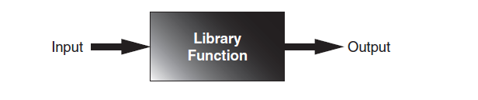
Standard Library Functions and the import Statement (cont’d.)

Slide 55
Generating Random Numbers
Random number are useful in a lot of programming tasks
random module: includes library functions for working with random numbers
Dot notation: notation for calling a function belonging to a module
  Format: module_name.function_name()

Slide 56
Generating Random Numbers (cont’d.)
randint function: generates a random number in the range provided by the arguments
  Returns the random number to part of program that called the function
  Returned integer can be used anywhere that an integer would be used
  You can experiment with the function in interactive mode

Slide 57
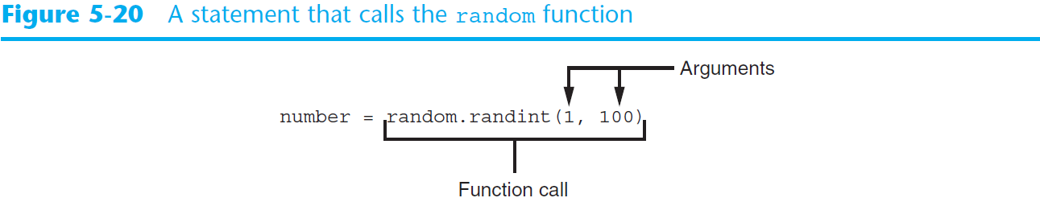
Generating Random Numbers (cont’d.)

Slide 58
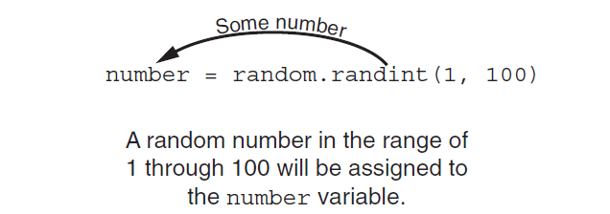
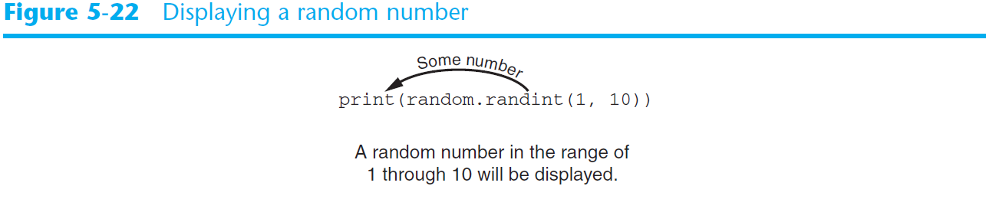
Generating Random Numbers (cont’d.)

Slide 59
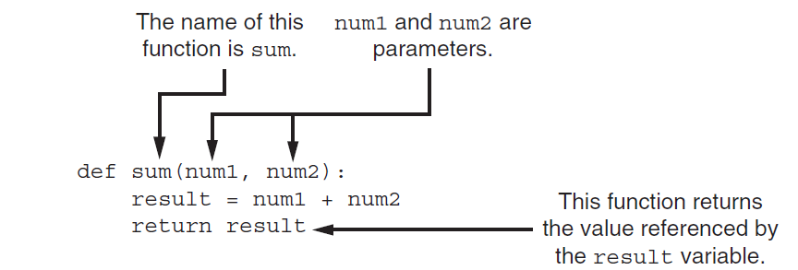
Writing Your Own Value-Returning Functions (cont’d.)

Slide 60
Storing Functions in Modules
In large, complex programs, it is important to keep code organized
Modularization: grouping related functions in modules
  Makes program easier to understand, test, and maintain
  Make it easier to reuse code for multiple different programs
    Import the module containing the required function to each program that needs it

